Slide 1
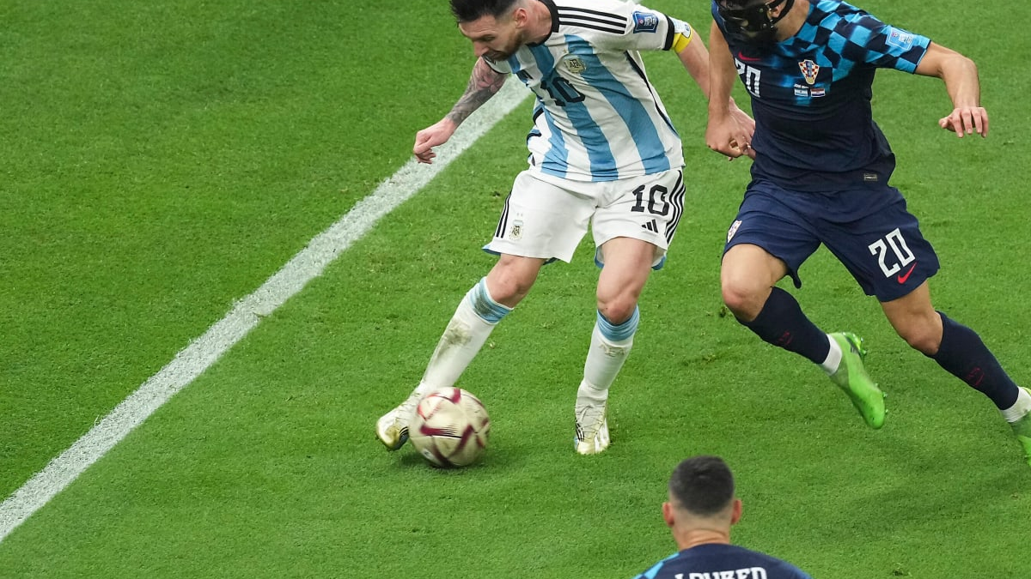
Breaking Down Messi’s Passing Ability
Introduction
Consistency
Decision-Making
Effective Pass Areas
Recommendations
Measures:
Consistency – Does this player complete passes at a high success rate?
Decision-Making – Did this player make the best pass given his circumstances?
Location of Dangerous Passes – Which areas is this player most dangerous from?

Slide 2

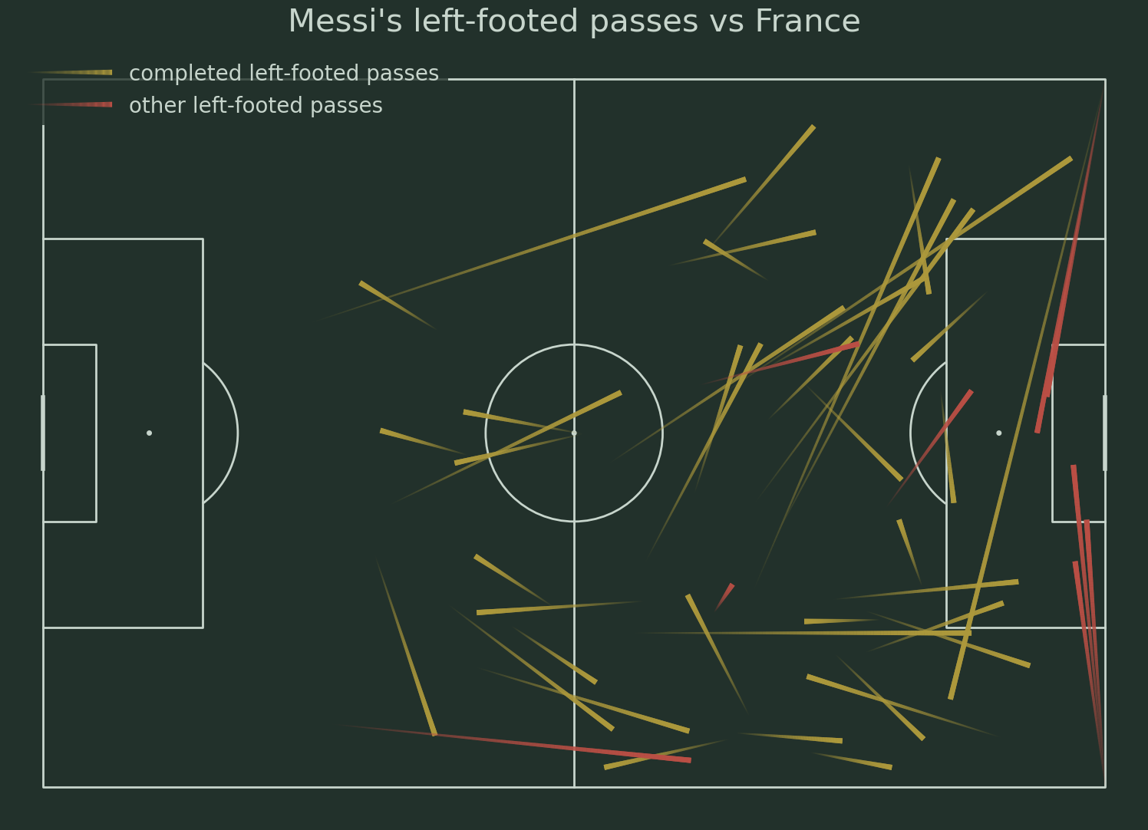
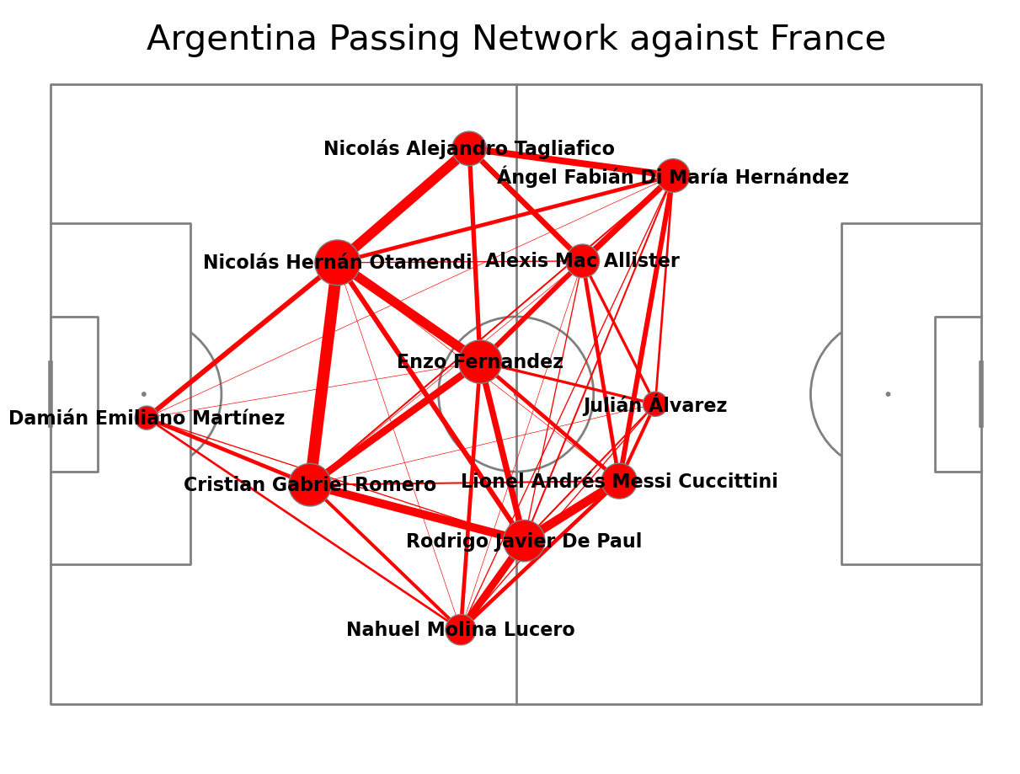
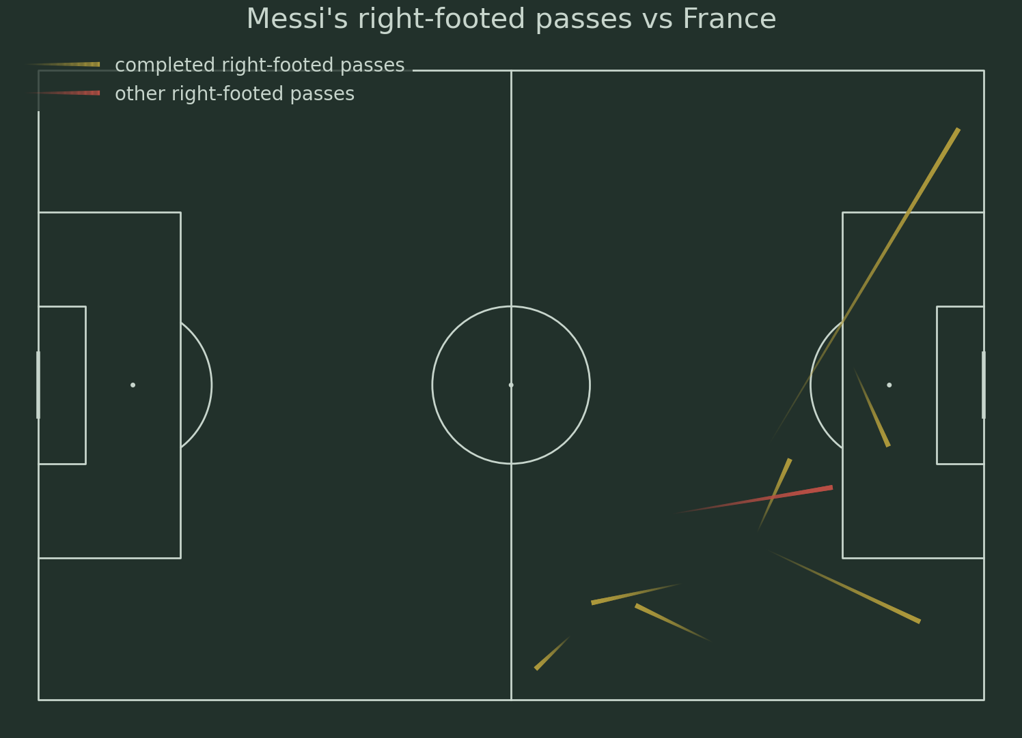
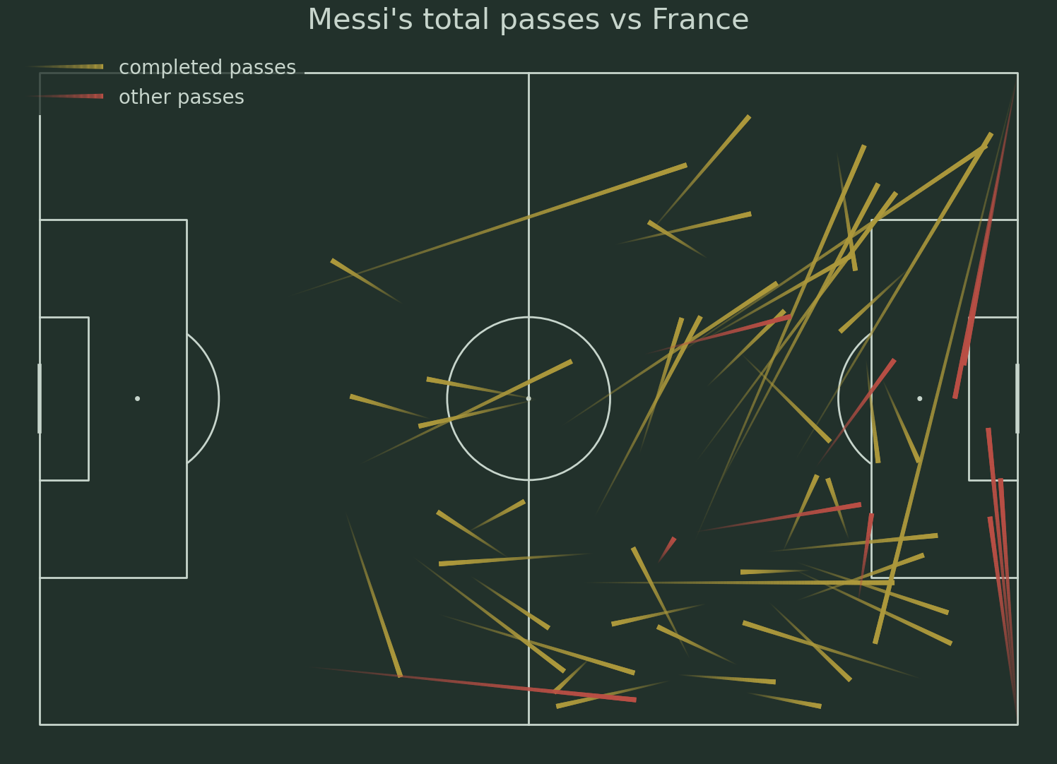
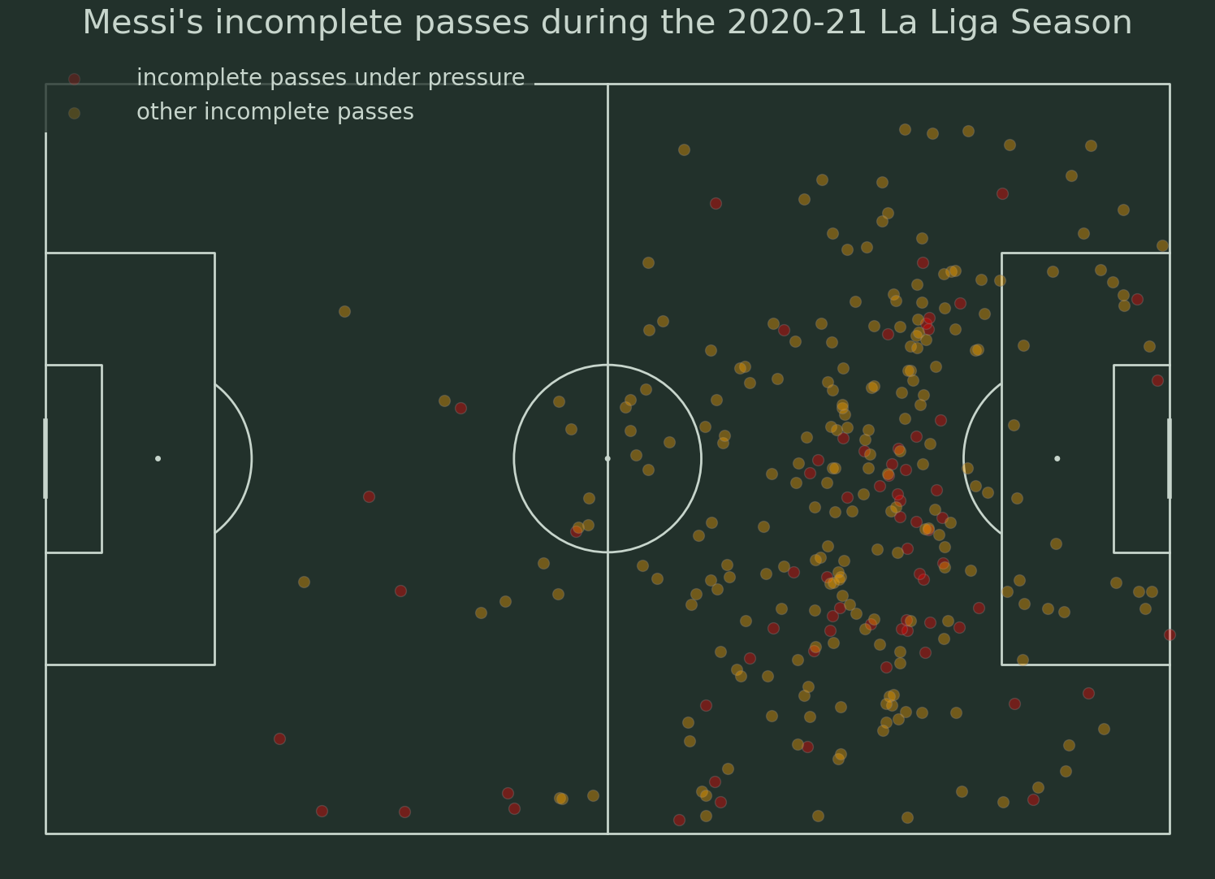
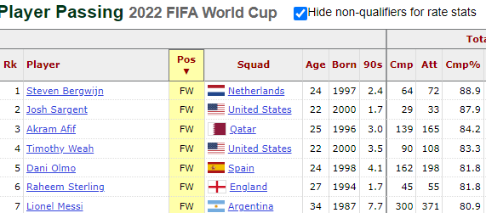





Introduction
Consistency
Decision-Making
Effective Pass Areas
Recommendations
44/51 passes completed
86% pass completion rate
7/8 passes completed
87.5% pass completion rate
Figure 2.1 plots all of Messi’s passes where he used his left-foot to pass the ball. Other passes include passes that were incomplete, out, offside, and where the outcome was unknown.
Figure 1 displays the average position between each player’s location when receiving a pass and their location when passing the ball. Larger circles are used for players who are more involved in passing plays. Passing networks that were used frequently are represented with thicker lines.
Figure 2.2 plots all of Messi’s passes where he used his right-foot to pass the ball. Other passes include passes that were incomplete, out, offside, and where the outcome was unknown.
51/59 passes completed
86% pass completion rate
Table 1 displays all qualified players in the 2022 FIFA World Cup from order of highest pass completion % filtered by position. The column ‘90s’ takes the player’s total minutes played during the competition and divides them by 90. The column ‘Att’ measures the total passes attempted during the competition
138/594 incomplete passes under pressure
Rate = 23%
51/59 passes completed
86% pass completion rate
Figure 2.3 plots all of Messi’s total passes from this match. Other passes include passes that were incomplete, out, offside, and where the outcome was unknown.
Figure 3 plots the location of all of Messi’s incomplete passes from the 2020-21 La Liga season. His incomplete passes where he was under pressure are plotted by the red dots while all of his other incomplete passes are plotted by the yellow dots.

Slide 3
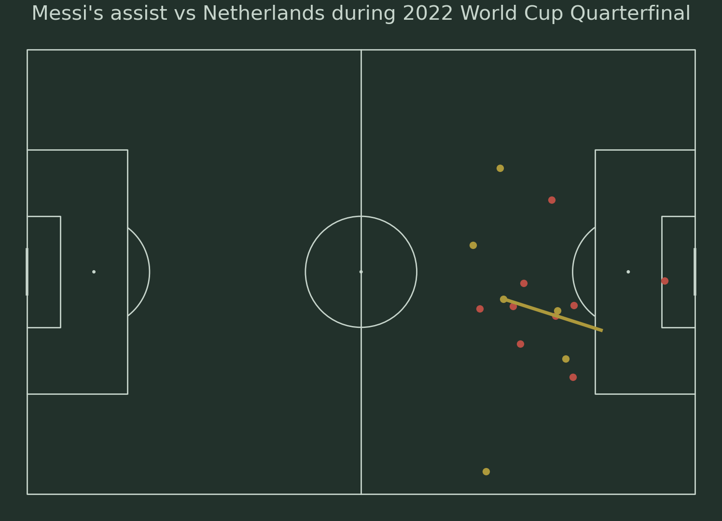
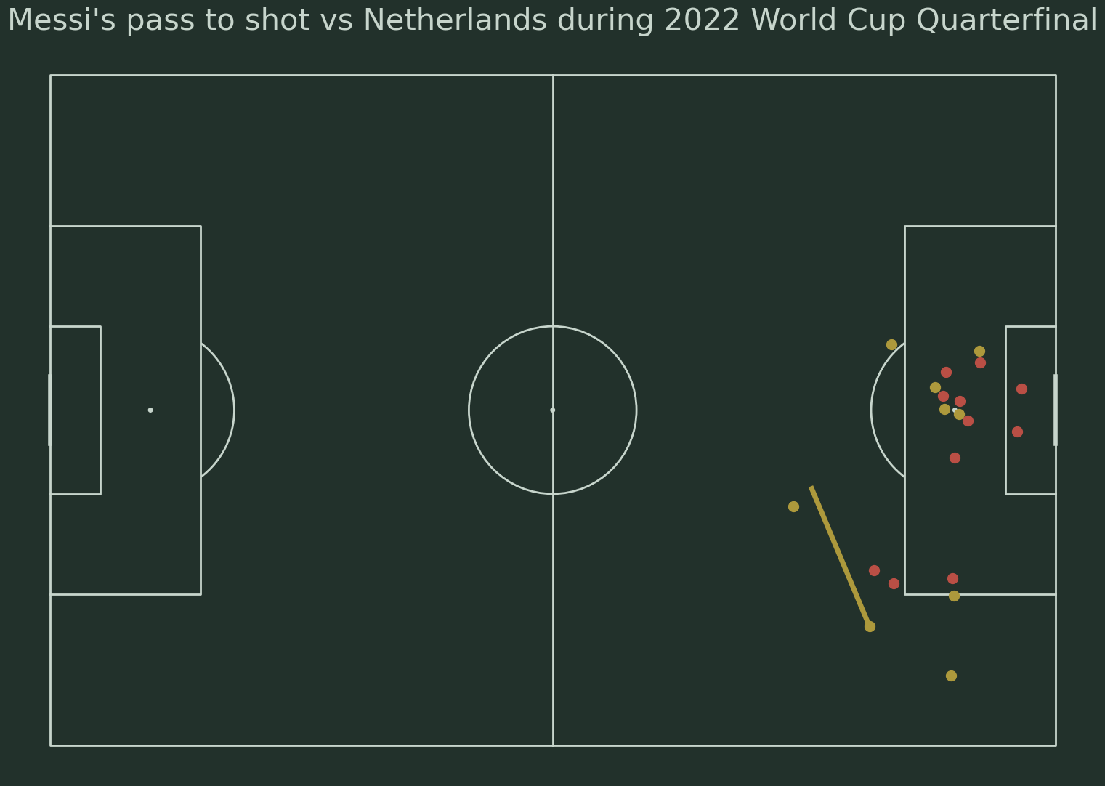
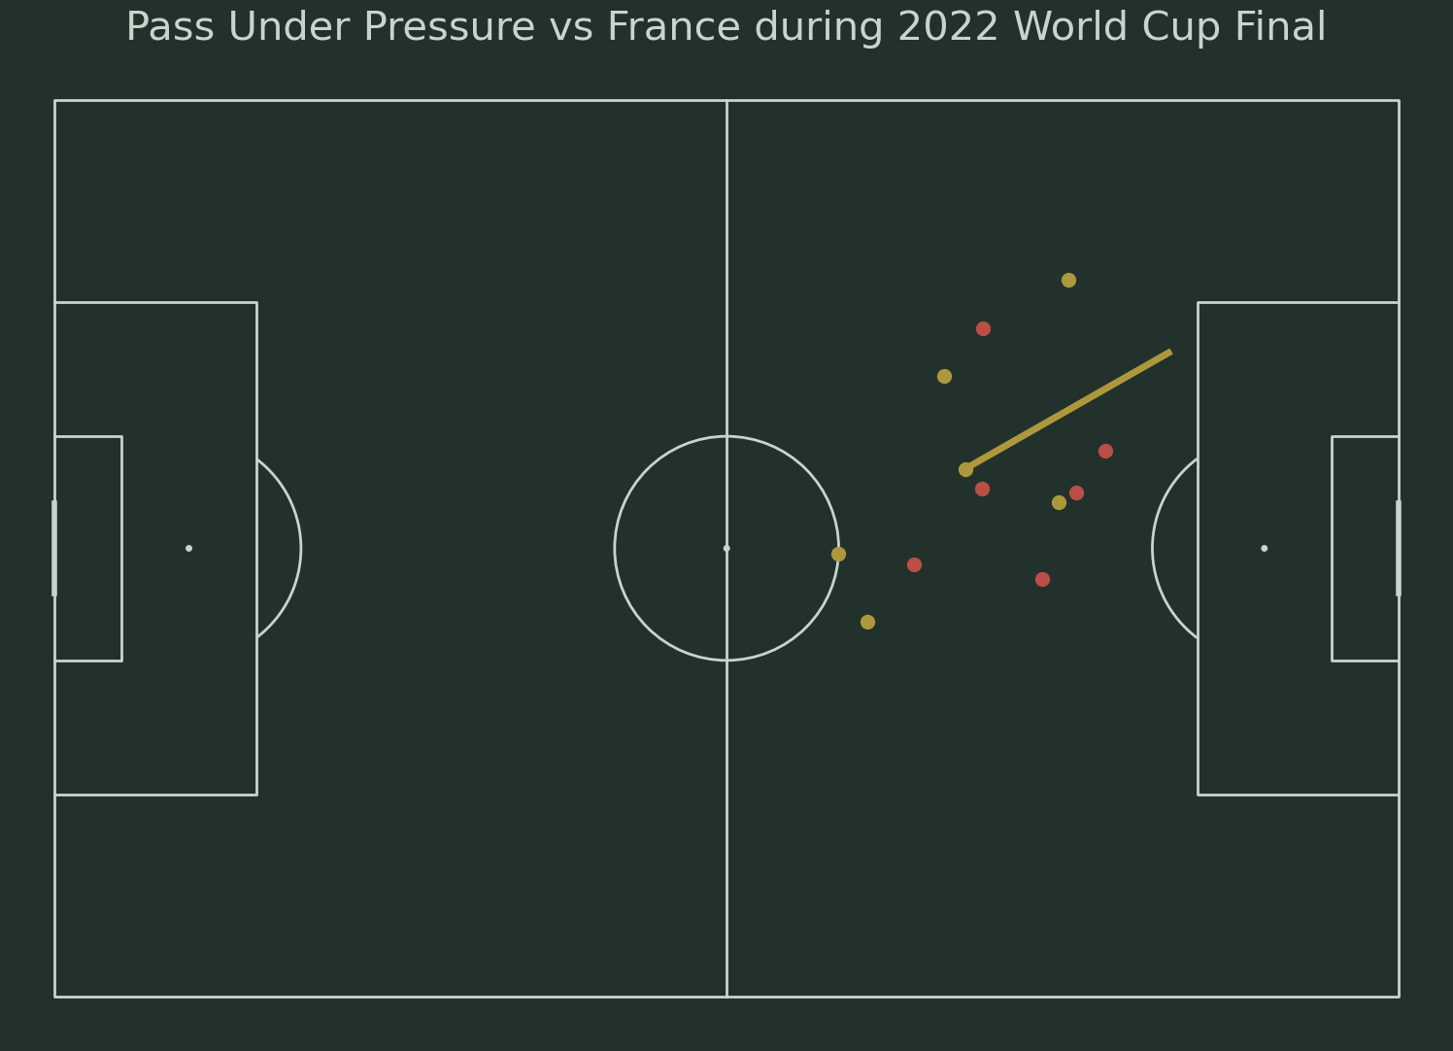
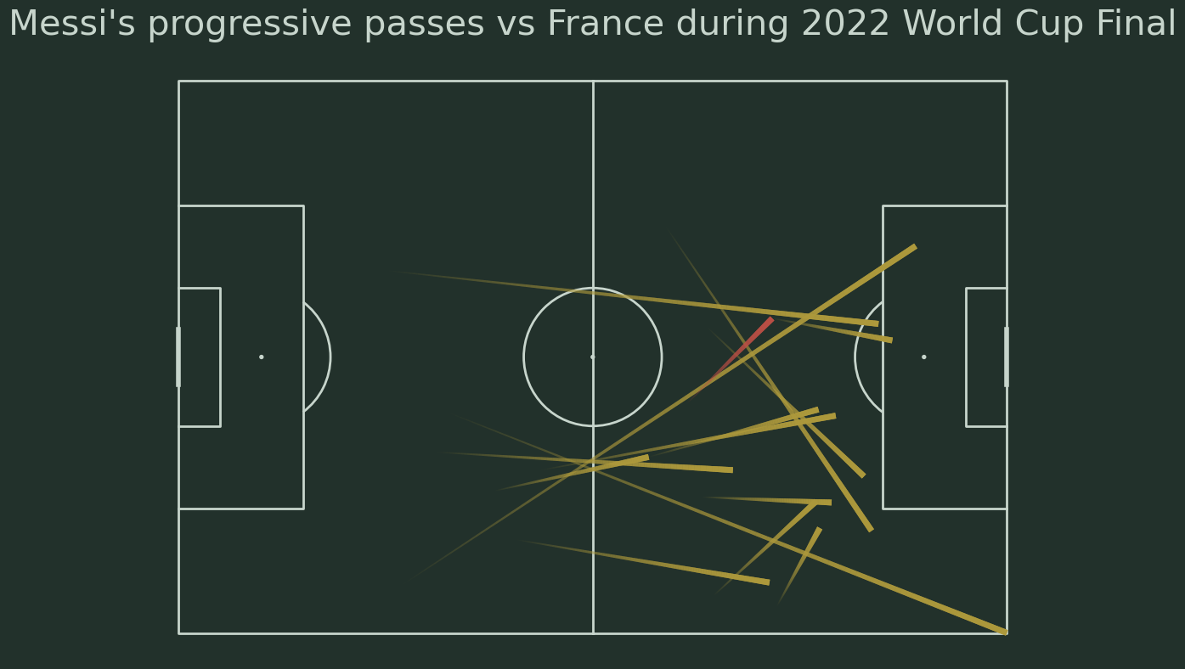
Introduction
Consistency
Decision-Making
Effective Pass Areas
Recommendations
Figure 3 plots this assist with freeze frame data from Statsbomb 360. The blue circle at the start of the line segment represents Messi’s location at the time of the pass and the line segment represents the pass. The location of his teammates are represented by the blue dots, while the location of the opposing players are represented by the red dots.
Figure 4 plots one of Messi’s passes that led to a shot during this match using freeze frame data from Statsbomb 360. The blue circle at the start of the line segment represents Messi’s location at the time of the pass and the line segment represents the pass. The location of his teammates are represented by the blue dots, while the location of the opposing players are represented by the red dots.
Figure 5 plots one of Messi’s passes under pressure from this match using freeze frame data from Statsbomb 360. The blue circle at the start of the line segment represents Messi’s location at the time of the pass and the line segment represents the pass. The location of his teammates are represented by the blue dots, while the location of the opposing players are represented by the red dots.
Figure 6 plots all of Messi’s progressive passes against France during the 2022 FIFA World Cup Final. Progressive passes are passes that are at least 30 meters in length if it begins and ends in the passer’s own half, or it is at least 15 meters in length if it begins in the passer’s own half and passes into the opponents’ half, or it is at least 10 meters in length if the pass begins and ends in the opponents’ half. Completed passes are marked in blue while incomplete passes are plotted in red. The pass begins in the narrow end of the line and ends at the thicker end of the line.

Slide 4
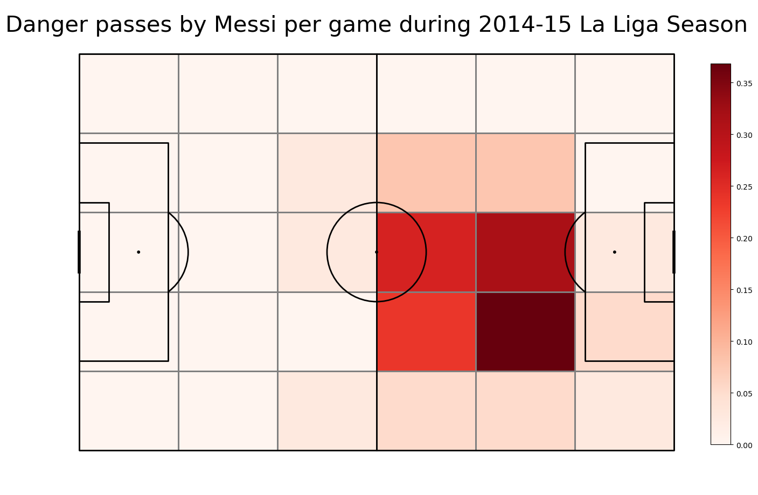
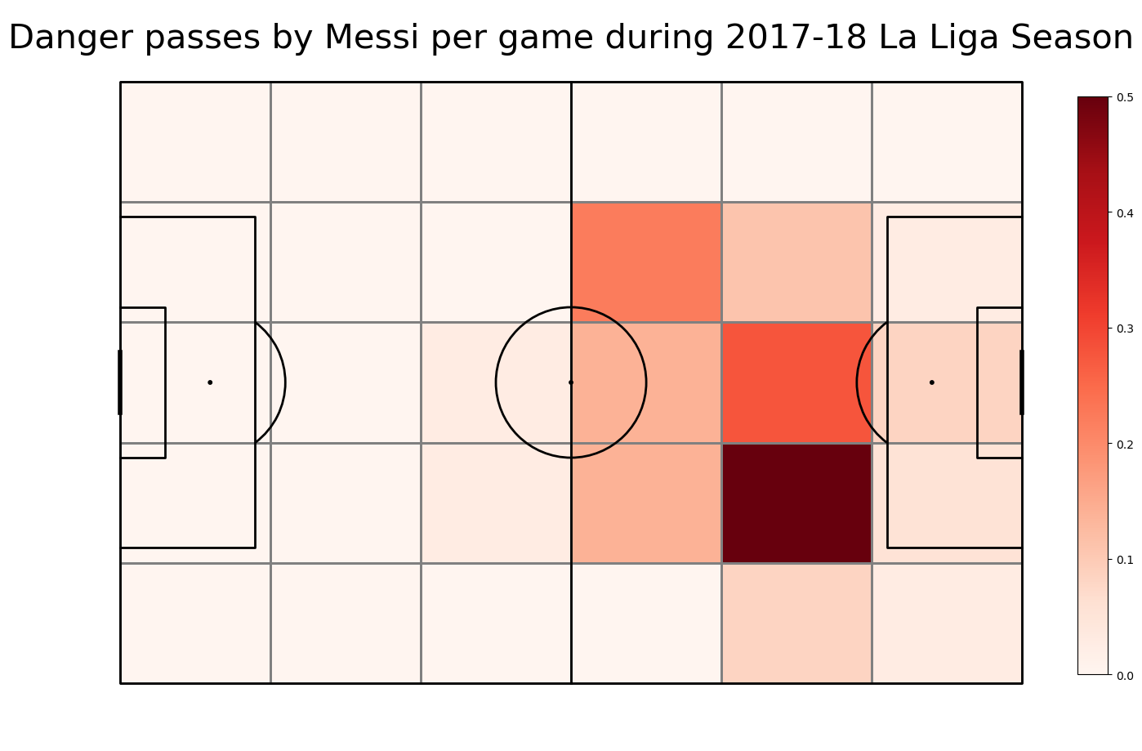
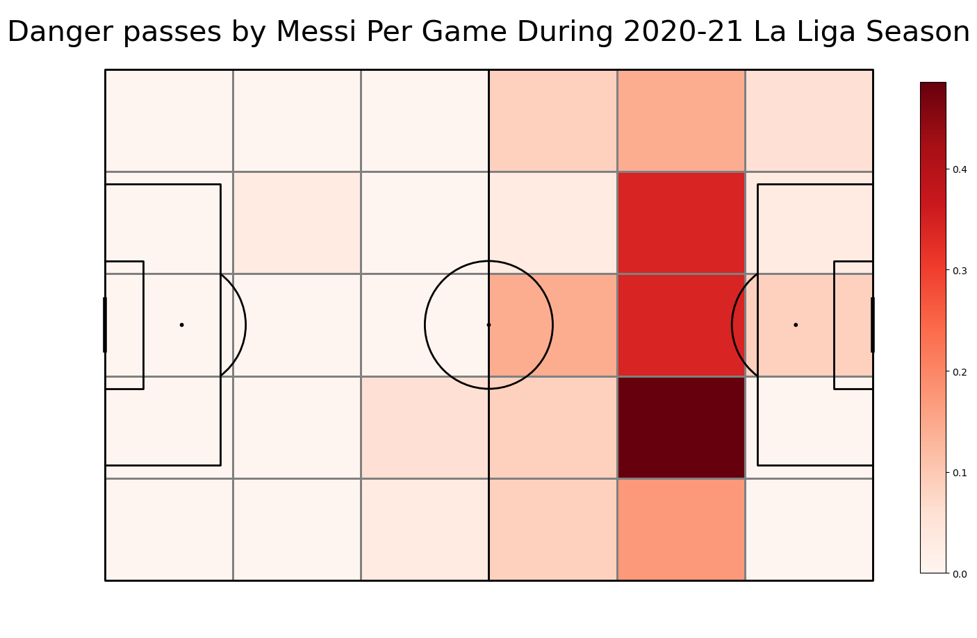
Introduction
Consistency
Decision-Making
Effective Pass Areas
Recommendations
Danger Pass – A pass executed within 15 seconds of a shot on goal by the team with ball possession
Figure 7.1 displays a heat map that showcases Messi’s danger passes per game during the 2014-15 La Liga Season. Areas where he executed more danger passes per game are shaded in dark red.
Figure 7.2 displays a heat map that showcases Messi’s danger passes per game during the 2017-18 La Liga Season. Areas where he executed more danger passes per game are shaded in dark red.
Figure 7.3 displays a heat map that showcases Messi’s danger passes per game during the 2020-21 La Liga Season. Areas where he executed more danger passes per game are shaded in dark red.
Notes:
He is very capable of completing long passes. Even from his defending half

Slide 5

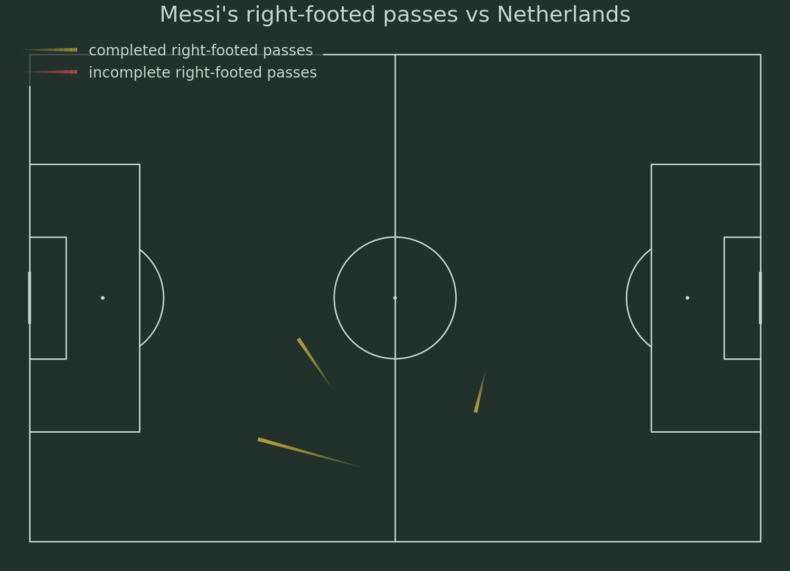


Introduction
Consistency
Decision-Making
Effective Pass Areas
Recommendations
Messi’s coaching staff:
- Enable Messi to receive the ball in his most dangerous areas by positioning him deep up the pitch when attacking
- Select players who are effective on the counter-attack and are good with link up play
- Enable him to drop deeper into the midfield to open opportunities for long progressive passes if the defense is denying the ball from progressing up the pitch
Opposing Coaching staff:
- Drop central midfielders or wingers into narrow positions to protect danger areas displayed in Figure 7.3
- Deny him time and space by pressing hard or commit to dropping back and defend against long progressive passes when he receives the ball in the middle third
- Pressure him aggressively in areas marked in blue in Figure 3 (areas where he is more prone to committing ‘incomplete passes under pressure’)
- Force him to pass the ball with his weak foot to get him out of his comfort zone (3 total weak foot passes vs Netherlands)
* Note: recommendations should be adjusted based match related factors such as lineups, pace of play, tactics, and score
Notes:
Players to surround him by

